Slide 1
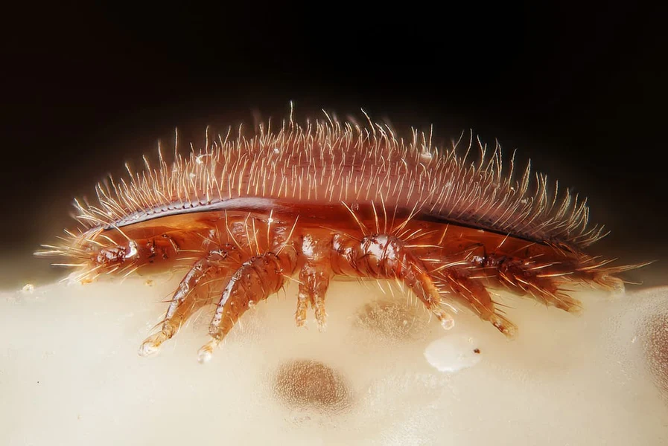

VARROA DESTRUCTOR
FDBKA 7 November 2024
By Alan Baxter

Slide 2
CONTENT
The origins and biology of Varroa destructor
What happens to your bees when Varroa feeds on them
Varroa and the viruses that are vectored by Varroa
Parasitic mite syndrome
Monitoring for mite levels
The treatments to reduce the varroa load
Treatment-free colonies

Slide 3
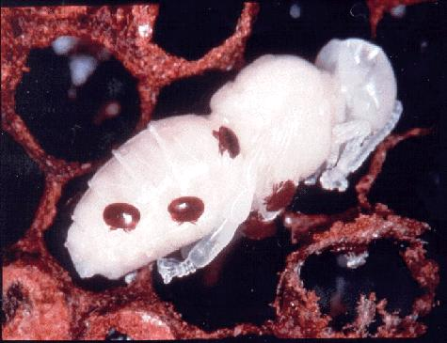

What is varroa
An ectoparasitic mite
of honey bee brood

Slide 4
Native to southeast Asia.
Co-evolved with the Asian honey bee Apis cerana.
Apis mellifera introduced into Japan & Russia in the 19th C.
Varroa spread into A.mellifera.
First found in A.m. in Japan in 1957.
Now found in most countries in the world.

Slide 5
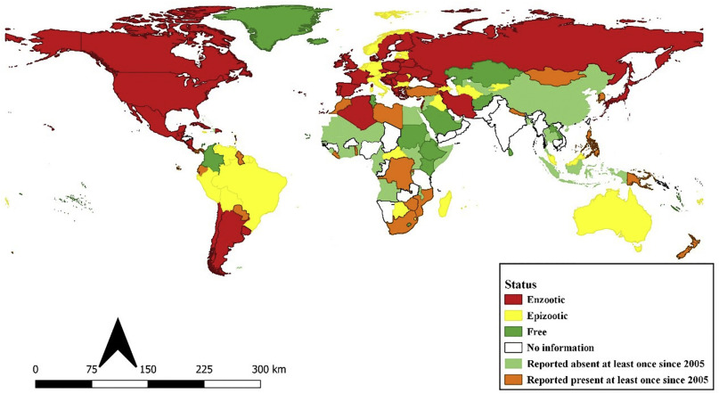

Slide 6
Why is it bad for our honey bees and not the Asian ones?
Brood parasite – feeds on the fat body of the pupa.
A.cerana only feeds on drone brood
Grooming and hygienic behaviours to remove the mites.
Neglect drone brood. Mites entombed and die.

Slide 7
In Europe varroa feeds on both drone and worker brood
European bees don’t entomb the infected brood
Don’t have the evolved hygienic behaviours of the Asians
Open season for the mites

Slide 8
Varroa female – foundress - lays egg
Punctures the larva to establish a feeding point.
60 hours later the first egg develops into a male
30 hour interval more eggs which develop into females
Male mates with his sisters
New bee emerges with female mites
Male mite dies in the cell
Worker bees emerge after 21 days – average 1.5 new mites
Drones emerge after 24 days – average 2.6 new mites
Life cycle

Slide 9
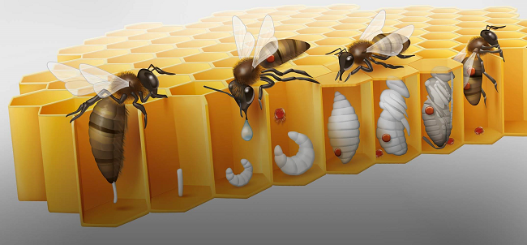

Slide 10
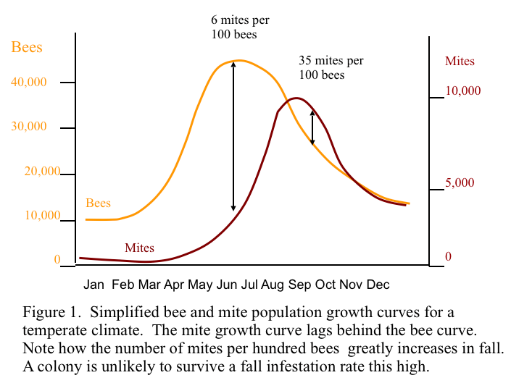
Population doubles every 21-24 days

Slide 11
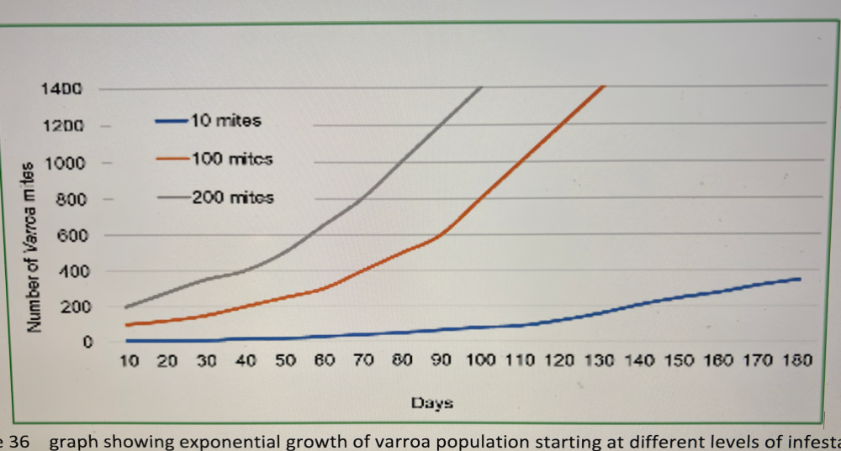

Slide 12
Effects
Bite on the pupa
Wound allows bacteria to accumulate – infected
Infested pupae have weight reduction
Proteins in mite saliva inhibits wound healing
Mites carry the DWV virus which enters through the wound
Suppress immune system.

Slide 13
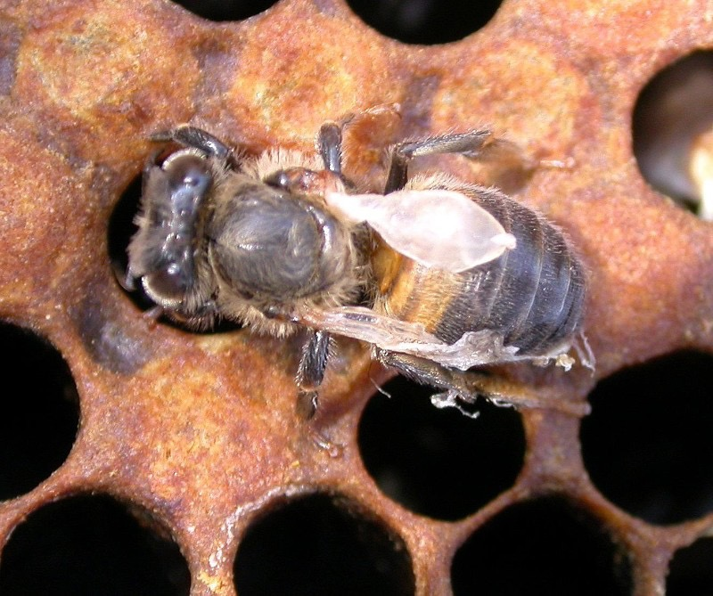
Deformed Wing Virus (DWV)

Slide 14
DWV
Transmitted at low levels from parent to offspring or adult to adult is less virulent.
When transmitted by mouthparts of varroa more concentrated dose.
Acute lethal infection in pupa.
Chronic infection in adult bee.

Slide 15
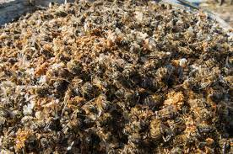
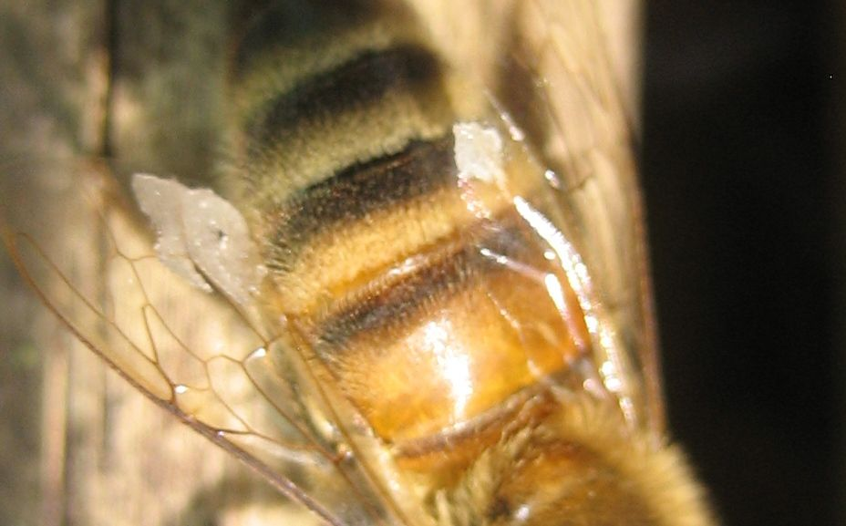
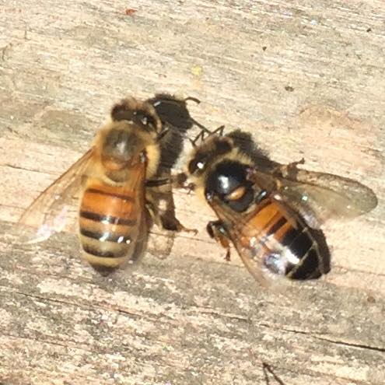
OTHER JOLLY VIRUSES
Acute bee paralysis virus
Cloudy wing virus
Slow paralysis virus
Israeli acute paralysis virus
Colony collapse disorder

Slide 16
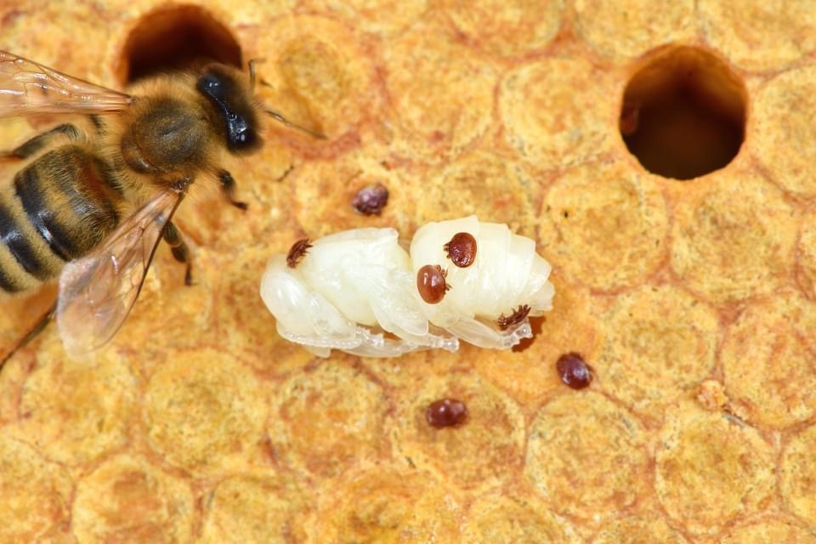
PARASITIC MITE SYNDROME

Slide 17
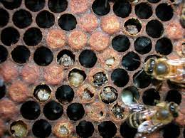
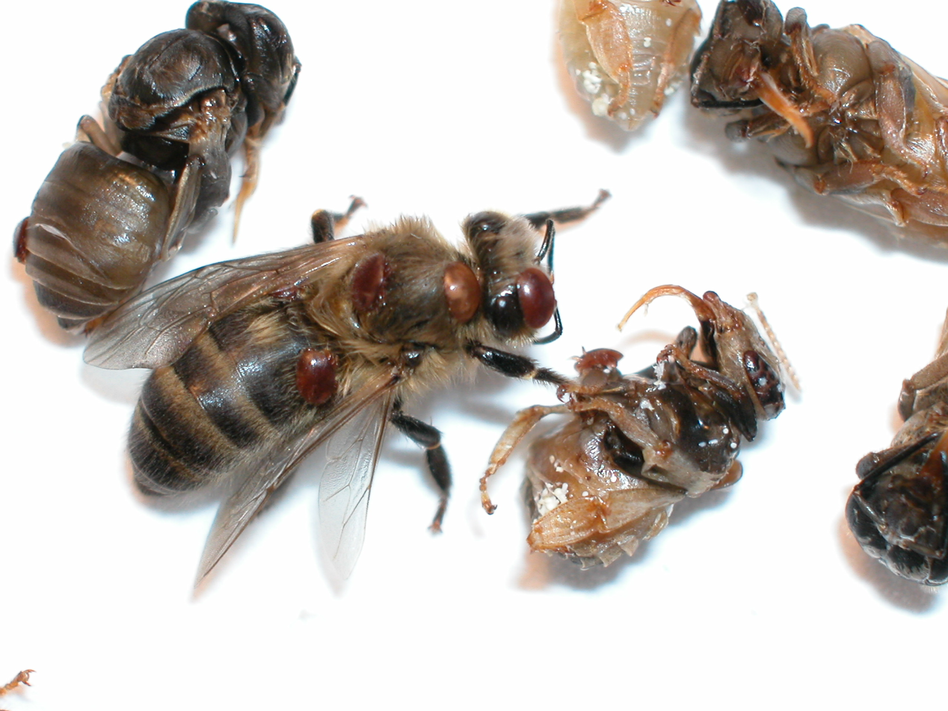
PARASITIC MITE SYNDROME SIGNS
Nibbled or perforated cappings
Chewed or cannibalized pupae
Dead pupae
Adults with deformed wings
Spotty brood pattern
Supersedure cells
Neglected brood
Aggression

Slide 18
PREVENTION
Regular testing/monitoring
IPM
Drone Brood uncapping/removal
Comb trapping
Shook swarm
Miticides*
Collected swarms (in quarantine)
Oxalic acid – gas vap

Slide 19
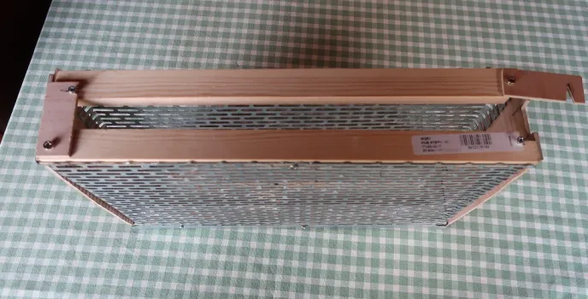
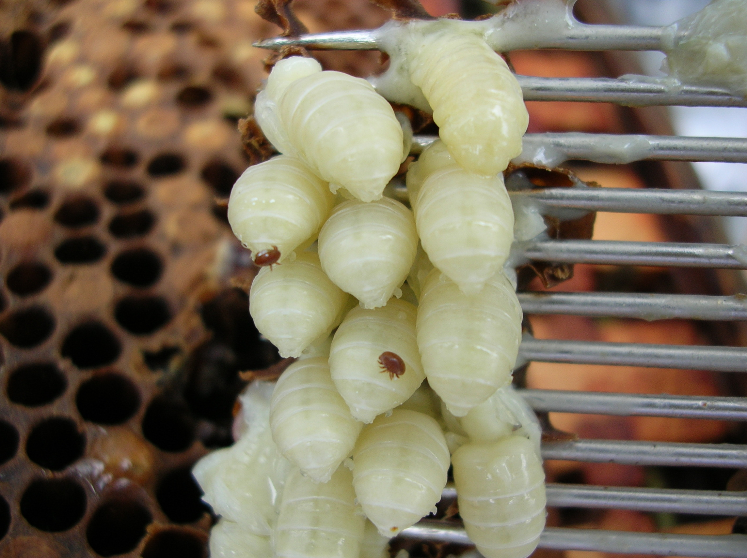
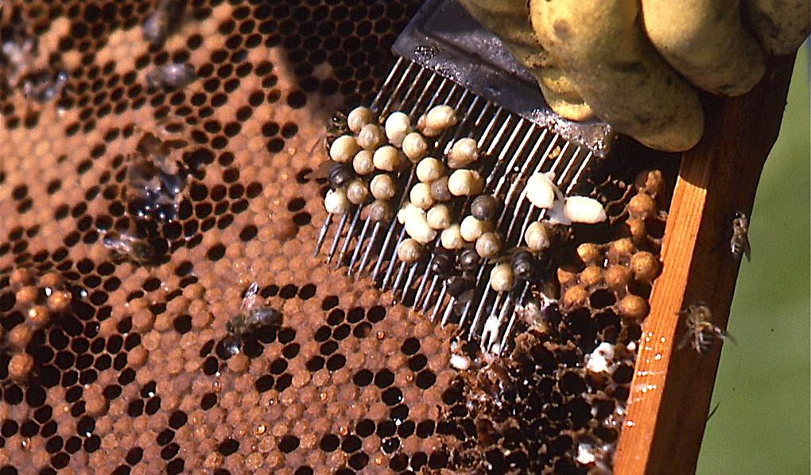
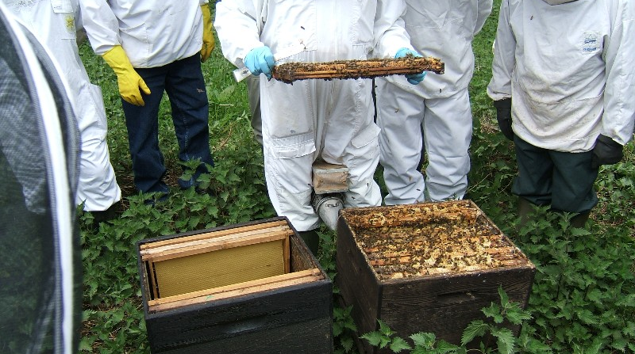

Slide 20
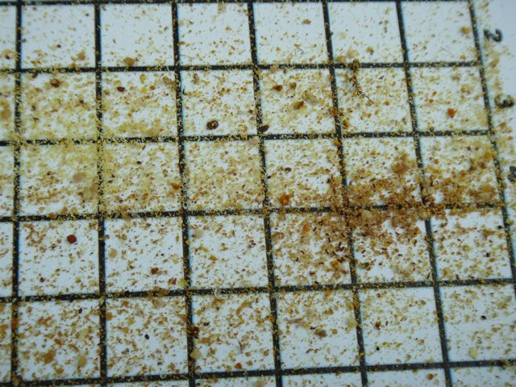
Check your varroa board regularly

Slide 21
NBU GUIDELINES
  Monitoring period 7 days
  Count the number of mites and divide by 7
  Multiply the daily drop by one of the following:
    November to February x 400
    May to August x 30
    March, April, September, October x 100
Maximum threshold of mites per colony: 1,000.
Treatment should begin before this level is reached

Slide 22
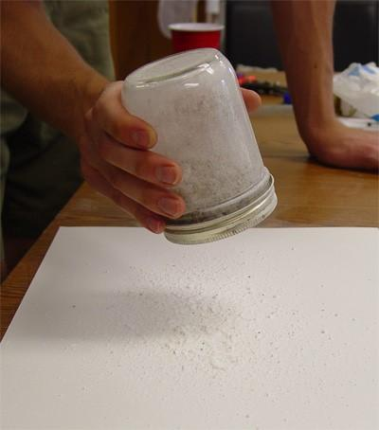
Sugar roll
300 Bees
Caster sugar
Roll container
Shake onto white surface
Divide by 3
Less than 3%

Slide 23
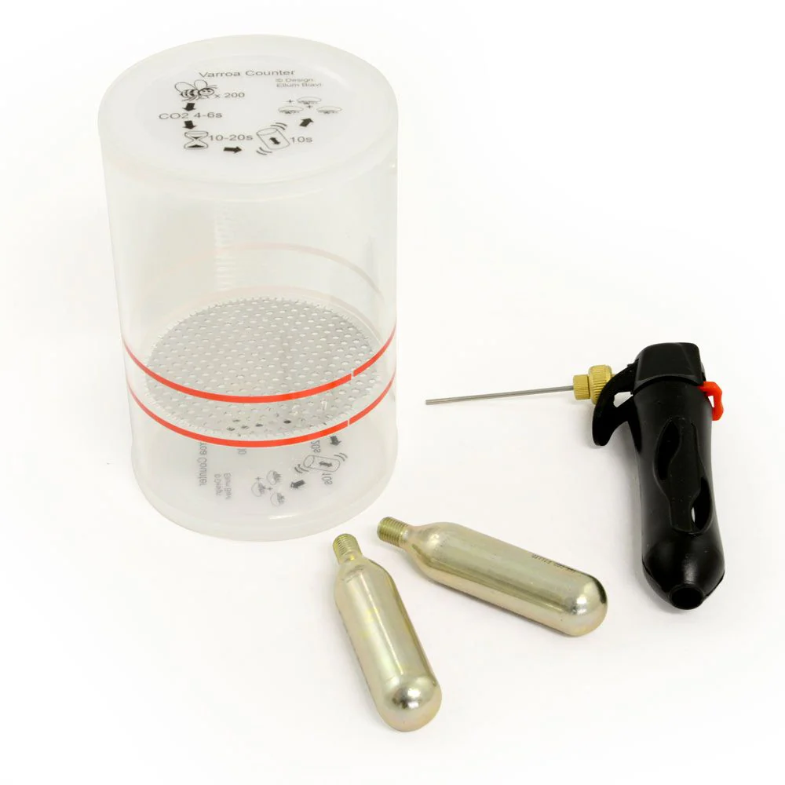
CO2
300 bees
Whiff of CO2
Count the mites & divide by 3
Return bees to hive

Slide 24
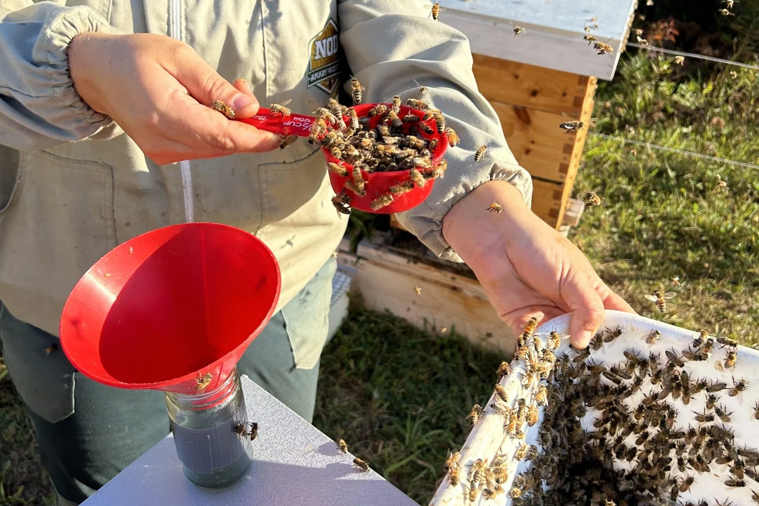
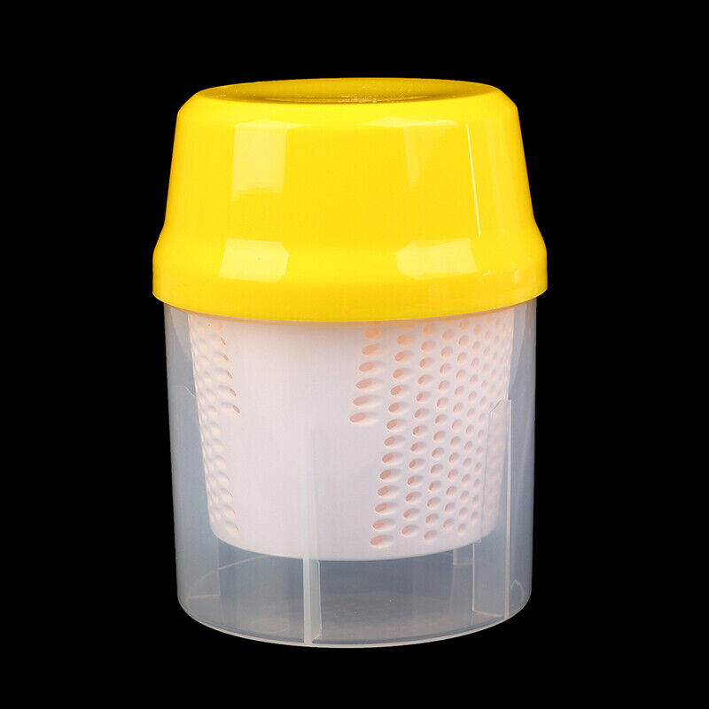
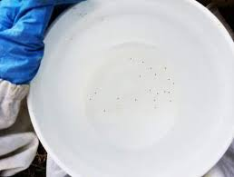
Alcohol wash

Slide 25
TREATMENTS
Essential oils
Thymol
Other botanical oils
Organic acids
Oxalic acid
Formic acid
Synthetic pesticides
Amitraz
Tau fluvinate
Flumethrin

Slide 26
TIMING OF TREATMENTS
Winter – broodless period – Oxalic acid
Spring – as needed – Miticide or Oxalic acid
Late summer – Miticide after honey harvest
Collected swarms – broodless period -Oxalic acid
After shook swarm - broodless period - Oxalic acid

Slide 27
Best spring treatment
Drone brood removal
Best summer treatment
Formic acid
Best autumn treatment
Apiguard
Best winter treatment
Oxalic acid
ALWAYS FOLLOW THE MAKER’S INSTRUCTIONS TO THE LETTER

Slide 29
TREATMENT FREE
Apis mellifera did not evolve with Varroa destructor
New pest introduced to a naïve population
Can result in population crash
Feral colonies swarm regularly so have a regular brood break and a new home
Honey bees kept in hives are managed livestock

Slide 30
Things to consider
It involves the death and suffering of a lot of honey bees
The survival rate of infested colonies is low
Gotland – no treatment for 20 years – isolated island in Baltic Sea
Selective breeding programme over very long period
Infestation impacts neighbouring apiaries

Slide 32
SUMMARY
Varroa destructor is a serious menace to our colonies of honey bees
Varroa is a parasite of brood
Vector for some nasty viruses
Exponential growth leads to rapid death of a colony if not dealt with
A mixture of chemical and non chemical interventions
can keep it under control

Slide 33
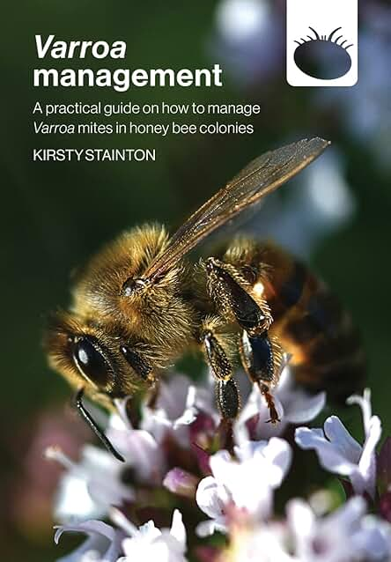
Further reading
https://www.nationalbeeunit.com/assets/PDFs/3_Resources_for_beekeepers/Advisory_leaflets/APHA_Managing_Varroa_2020_ELECTRONIC_ONLY-1.pdf

Slide 34
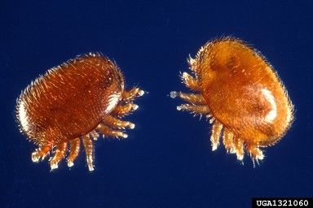
QUESTIONS

